Slide 1
The Hadoop Distributed File System
Konstantin Shvachko, Hairong Kuang, Sanjay Radia, Robert Chansler
Yahoo!
Sunnyvale, California USA
Presented by Ying Yang
9/24/2012

Slide 2
Outline
Introduction
Architecture
NameNode, DataNodes, HDFS Client, CheckpointNode, BackupNode, Snapshots
File I/O Operations and Replica Management
File Read and Write, Block Placement, Replication management, Balancer,
Practice at YAHoo!
FUTURE WORK

Slide 3
Introduction
HDFS
The Hadoop Distributed File System (HDFS) is the file system component of Hadoop. It is designed to store very large data sets (1) reliably, and to stream those data sets (2) at high bandwidth to user applications. These are achieved by replicating file content on multiple machines(DataNodes).

Slide 4
Outline
Introduction
Architecture
NameNode, DataNodes, HDFS Client, CheckpointNode, BackupNode, Snapshots
File I/O Operations and Replica Management
File Read and Write, Block Placement, Replication management, Balancer,
Practice at YAHoo!
FUTURE WORK

Slide 5
Architecture
HDFS is a block-structured file system: Files broken into blocks of 128MB (per-file configurable).
A file can be made of several blocks, and they are stored across a cluster of one or more machines with data storage capacity.
Each block of a file is replicated across a number of machines, To prevent loss of data.

Slide 6
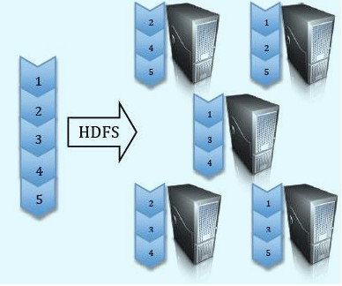
Architecture

Slide 7
Architecture
NameNode and DataNodes
HDFS stores file system metadata and application data separately.
Metadata refers to file metadata(attributes such as permissions, modification, access times, namespace and disk space quotas.
)called “inodes”+list of blocks belong to the file.
HDFS stores metadata on a dedicated server, called the NameNode.(Master) Application data are stored on other servers called DataNodes.(Slaves)
All servers are fully connected and communicate with each other using TCP-based protocols.(RPC)

Slide 8
Architecture
Single Namenode:
Maintain the namespace tree(a hierarchy of files and directories) operations like opening, closing, and renaming files and directories.
Determine the mapping of file blocks to DataNodes (the physical location of file data).
File metadata (i.e. “inode”) .
Authorization and authentication.
Collect block reports from Datanodes on block locations.
Replicate missing blocks.
HDFS keeps the entire namespace in RAM, allowing fast access to the metadata.
Notes:
Here yhy single NameNode? Will get the answer from expriment result from Yahoo! Later.
We will talk about each point later.

Slide 9
Architecture
DataNodes:
The DataNodes are responsible for serving read and write requests from the file system’s clients.
The DataNodes also perform block creation, deletion, and replication upon instruction from the NameNode.
Data nodes periodically send block reports to Namenode.
Notes:
Point one indicates that Clients access the blocks directly from data nodes, this is significant: HDFS exposes block placement so that computation can be migrated to data. The concept: bring computation to data instead of bring data to computation.

Slide 10
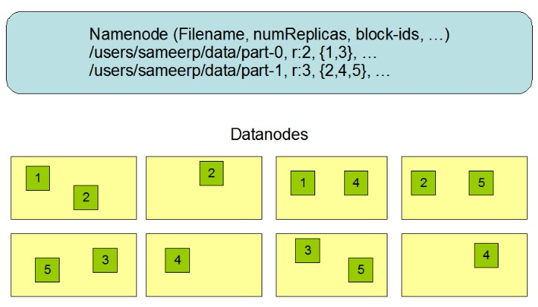
Architecture
Notes:
Overall picture of NameNode and DataNodes.

Slide 11
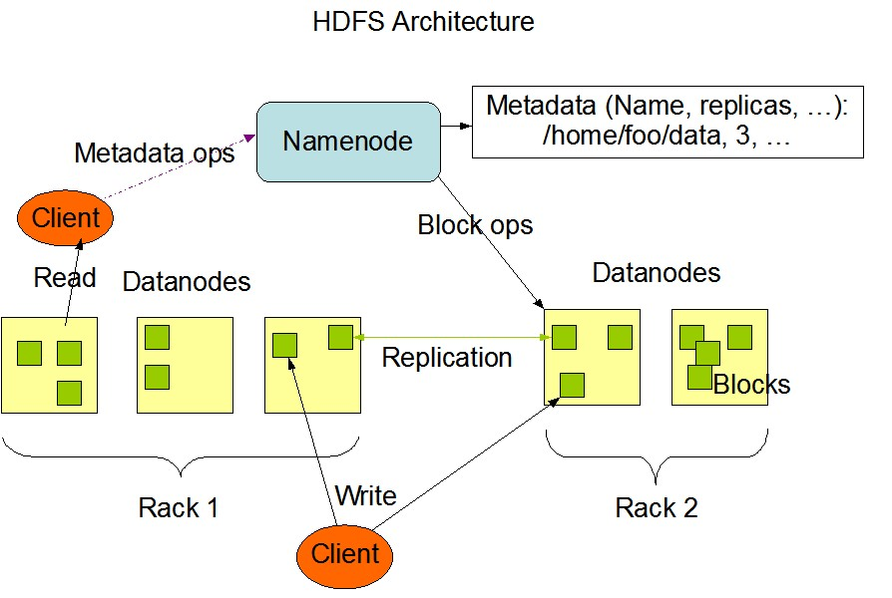
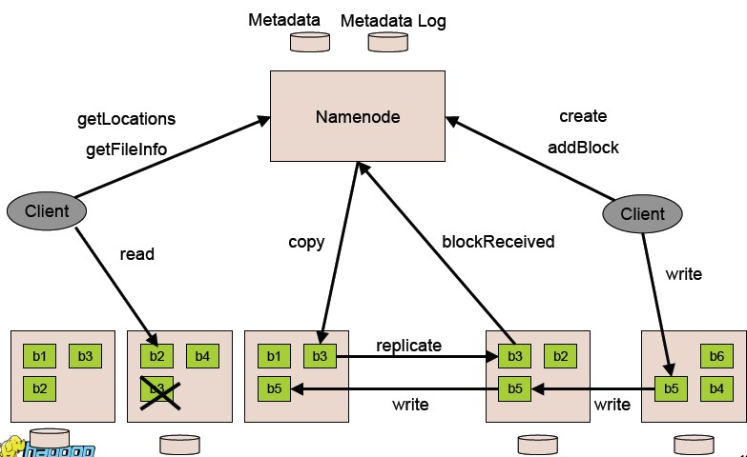
Architecture
Notes:
Divide into three parts: (left to right) Client read, DataNode replication, Client write.

Slide 12
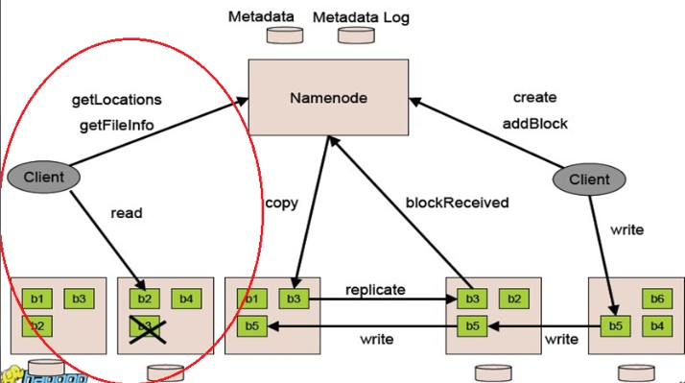
Architecture
Notes:
User has directly access to certain block of a file.

Slide 13
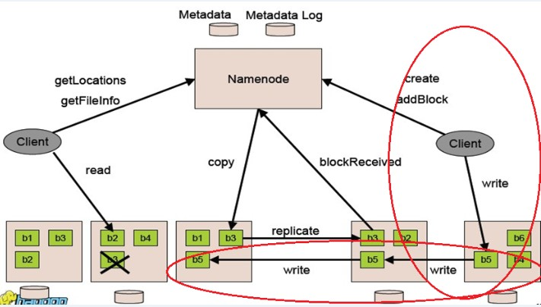
Architecture
Notes:
Client read and write will be talked a lot in details later .

Slide 14
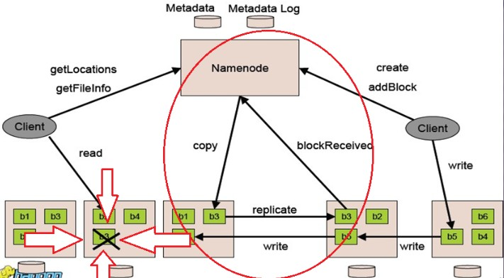
Architecture
Notes:
Question: How do NameNode know that b3 is dead so he can give instruction to another b3 to replicate and how the new copy of b3 notify NameNode that the block is replicated and its location?----Heartbeat, next slide.

Slide 15
Architecture
NameNode and DataNode communication: Heartbeats.
DataNodes send heartbeats to the NameNode to confirm that the DataNode is operating and the block replicas it hosts are available.

Slide 16
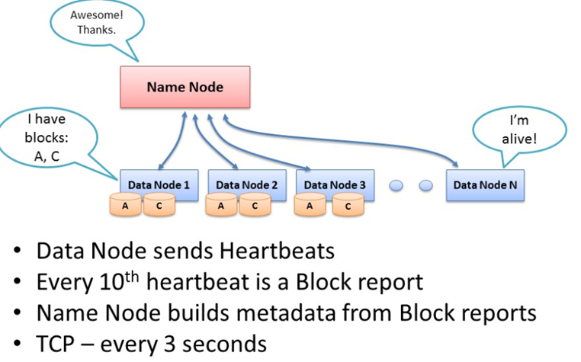
Architecture
Notes:
What is a block report?

Slide 17
Architecture
Blockreports:
A DataNode identifies block replicas in its possession to the NameNode by sending a block report. A block report contains the block id, the generation stamp and the length for each block replica the server hosts.
Blockreports provide the NameNode with an up-to-date view of where block replicas are located on the cluster and nameNode constructs and maintains latest metadata from blockreports.

Slide 18
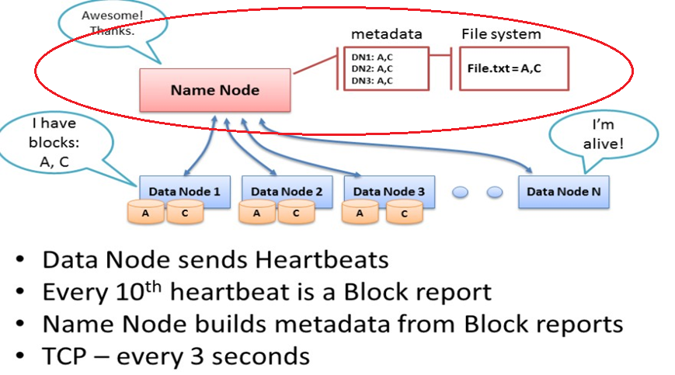
Architecture
Notes:
What is a block report?

Slide 19
Architecture
failure recovery
The NameNode does not directly call DataNodes. It uses replies to heartbeats to send instructions to the DataNodes. The instructions include commands to:
 replicate blocks to other nodes:
DataNode died.
copy data to local.
 remove local block replicas;
 re-register or to shut down the node;
Notes:
In order for nameNode to recognize and respond to failures, it must continually check the health of the cluster. Some of these checks are provided by the heartbeat function.

Slide 20
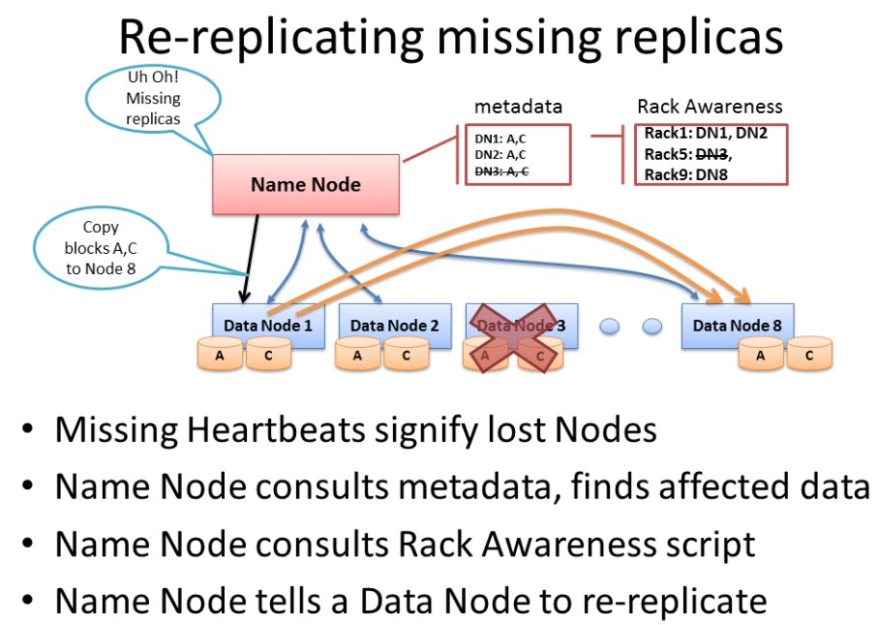
Architecture

Slide 21
Architecture
failure recovery
So when dataNode died, NameNode will notice and instruct other dataNode to replicate data to new dataNode. What if NameNode died?

Slide 22
Architecture
failure recovery
Keep journal (the modification log of metadata).
Checkpoint: The persistent record of the metadata stored in the local host’s native files system.
For example:
During restart, the NameNode initializes the namespace image from the checkpoint, and then replays changes from the journal until the image is up-to-date with the last state of the file system.

Slide 23
Architecture
failure recovery
CheckpointNode and BackupNode--two other roles of NameNode
CheckpointNode:
When journal becomes too long, checkpointNode combines the existing checkpoint and journal to create a new checkpoint and an empty journal.
Notes:
Why have the checkpointing done by a separate piece of hardware?
My answer: The CheckpointNode usually runs on a different host from the NameNode since it has the same memory requirements as the NameNode. It downloads the current checkpoint and journal files from the NameNode, merges them locally, and returns the new checkpoint back to the NameNode.

Slide 24
Architecture
failure recovery
CheckpointNode and BackupNode--two other roles of NameNode
BackupNode: A read-only NameNode
it maintains an in-memory, up-to-date image of the file system namespace that is always synchronized with the state of the NameNode.
If the NameNode fails, the BackupNode’s image in memory and the checkpoint on disk is a record of the latest namespace state.
Notes:
How is state mirrored from the checkpoint node to the backup node? Is this likely to have an impact on performance?
My answer: The BackupNode accepts the journal stream of namespace transactions from the active NameNode, saves them to its own
storage directories, and applies these transactions to its own namespace image in memory.
CheckpoingNode downloads the current checkpoint and journal files from the NameNode, merges them locally, and returns the new checkpoint back to the NameNode.
They do not contact directly and they do not have a big effect on the performance on nameNode since nameNode gave them data using two threads.

Slide 25
Architecture
failure recovery
Upgrades, File System Snapshots
The purpose of creating snapshots in HDFS is to minimize potential damage to the data stored in the system during upgrades. During software upgrades the possibility of corrupting the system due to software bugs or human mistakes increases.
The snapshot mechanism lets administrators persistently
save the current state of the file system(both data and metadata), so that if the upgrade results in data loss or corruption, it is possible to rollback the upgrade and return HDFS to the namespace and storage state as they were at the time of the snapshot.

Slide 26
Outline
Introduction
Architecture
NameNode, DataNodes, HDFS Client, CheckpointNode, BackupNode, Snapshots
File I/O Operations and Replica Management
File Read and Write, Block Placement, Replication management, Balancer,
Practice at YAHoo!
FUTURE WORK

Slide 27
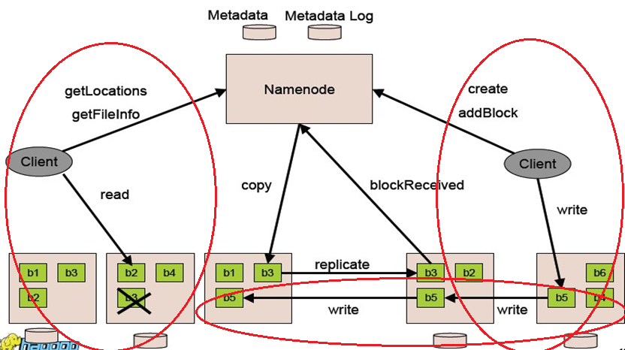
File I/O Operations and Replica Management

Slide 28
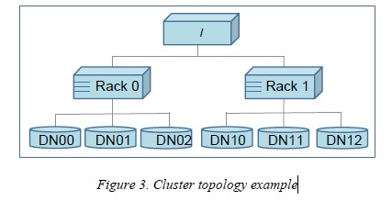
File I/O Operations and Replica Management
Hadoop has the concept of “Rack Awareness”.
Notes:
For a large cluster, it may not be practical to connect all nodes in a flat topology. A common practice is to spread the nodes across multiple racks. Nodes of a rack share a switch, and rack switches are connected by one or more core switches. Communication between two nodes in different racks has to go through multiple switches.

Slide 29
File I/O Operations and Replica Management
Hadoop has the concept of “Rack Awareness”.
The default HDFS replica placement policy can be summarized as follows:
1. No Datanode contains more than one replica of any block.
2. No rack contains more than two replicas of the same block, provided there are sufficient racks on the cluster.

Slide 30
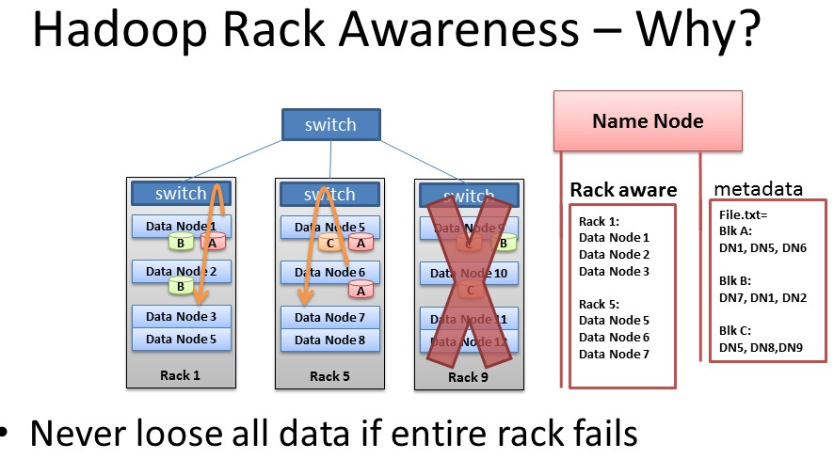
File I/O Operations and Replica Management

Slide 31
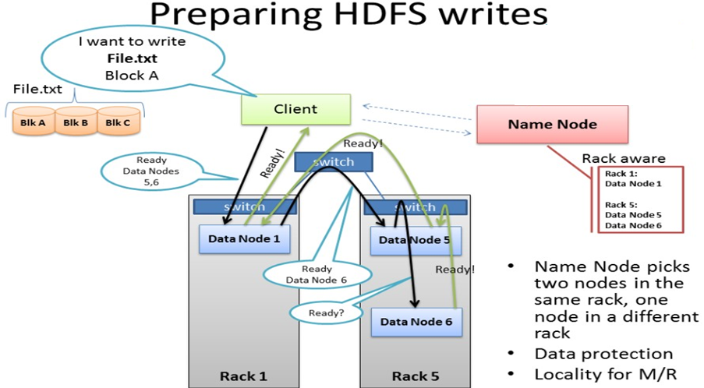
File I/O Operations and Replica Management
OK. Write to dataNode 1.
dsHey,DN1, duplicate Block A to DN5 and DN6.
Notes:
1When there is a need for a new block, the NameNode allocates a block with a unique block ID and determines a list of DataNodes to host replicas of the block.
2The DataNodes form a pipeline, the order of which minimizes the total network distance from the client to the last DataNode.

Slide 32
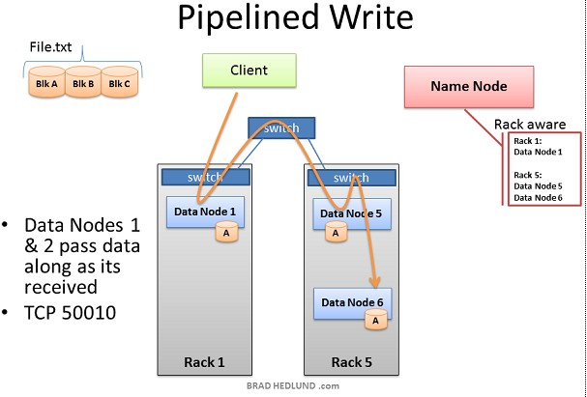
File I/O Operations and Replica Management
Notes:
3Bytes are pushed to the pipeline as a sequence of packets. The bytes that an application writes first buffer at the client side. After a packet buffer is filled (typically 64 KB), the data are pushed to the pipeline.

Slide 33
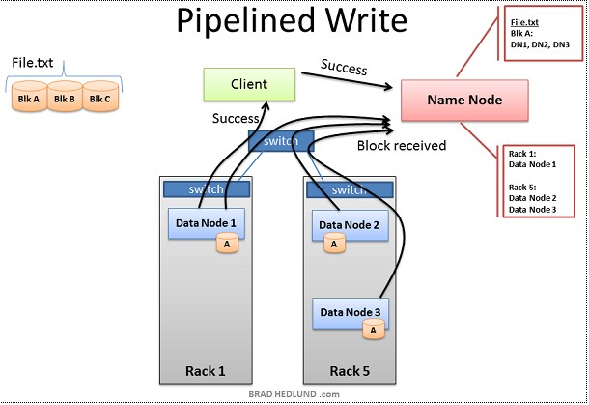
File I/O Operations and Replica Management

Slide 34
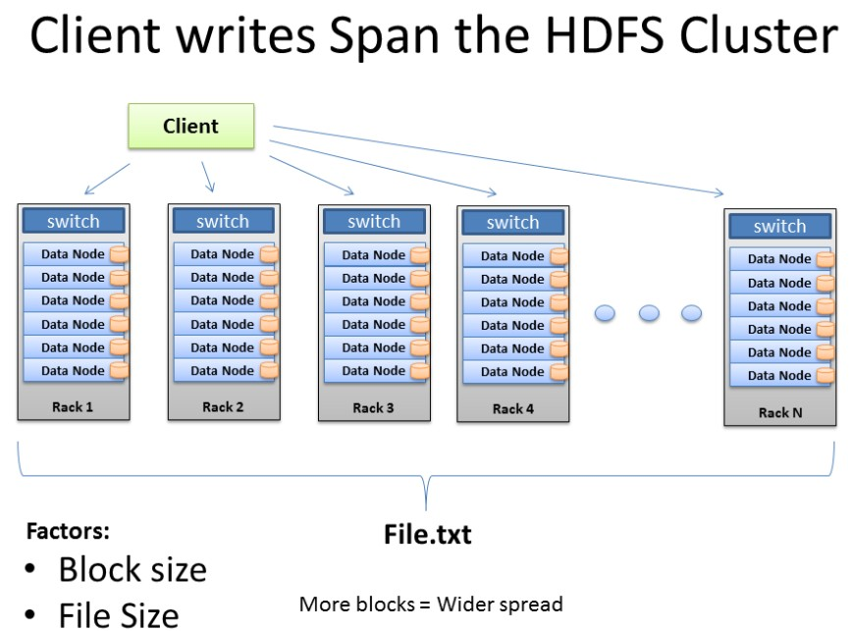
File I/O Operations and Replica Management
Notes:
The more blocks that make up a file, the more machines the data can potentially spread. The more CPU cores and disk drives that have a piece of my data mean more parallel processing power and faster results. This is the motivation behind building large, wide clusters. To process more data, faster.

Slide 35
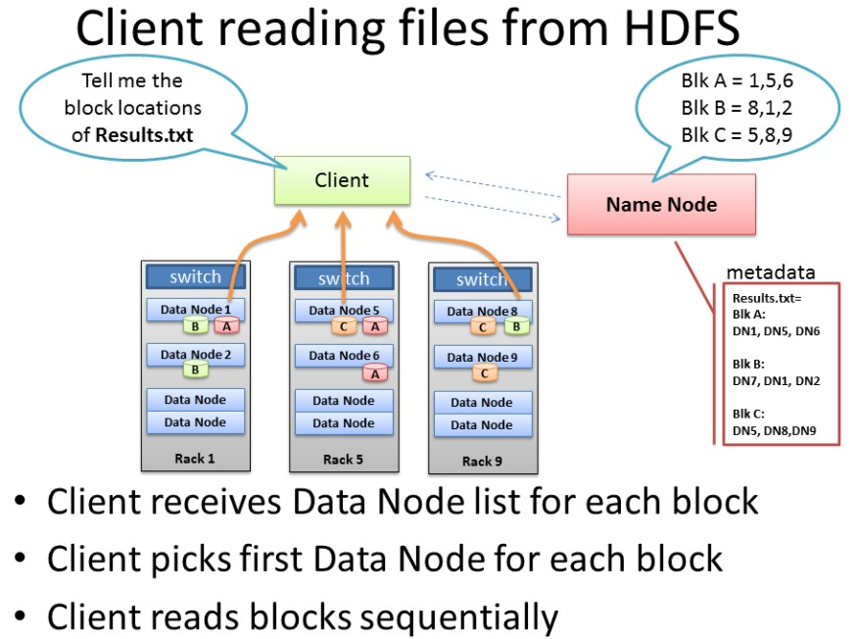
File I/O Operations and Replica Management
Notes:
In this graph, client just fetches the first of the block choices NameNode provided,(1,8,5) actually fetched in the order of the distance from the client.Give an example.

Slide 36
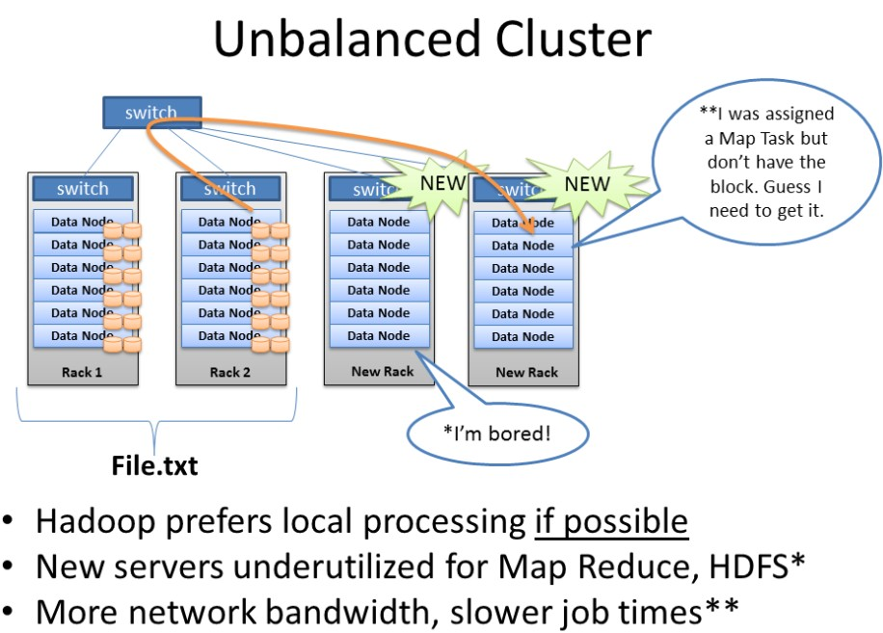
File I/O Operations and Replica Management
Balancer
Notes:
When we add new racks full of servers and network to an existing Hadoop cluster we can end up in a situation where our cluster is unbalanced. In this case, Racks 1 & 2 were my existing racks containing File.txt and running my Map Reduce jobs on that data. When I added two new racks to the cluster, my File.txt data doesn’t auto-magically start spreading over to the new racks. All the data stays where it is.
1.The new servers are sitting idle with no data, until I start loading new data into the cluster.
2.Furthermore, if the servers in Racks 1 & 2 are really busy, the Job Tracker may have no other choice but to assign Map tasks on File.txt to the new servers which have no local data.
3.The new servers need to go grab the data over the network. As as result you may see more network traffic and slower job completion times.

Slide 37
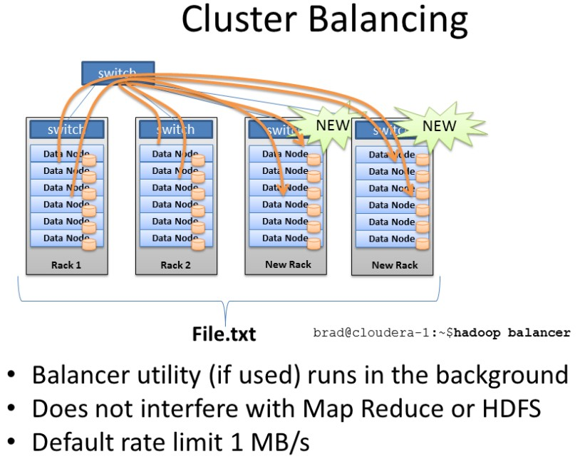
File I/O Operations and Replica Management
Balancer
Notes:
Balancer looks at the difference in available storage between nodes and attempts to provide balance to a certain threshold.
New nodes with lots of free disk space will be detected and balancer can begin copying block data off nodes with less available space to the new nodes.

Slide 38
Outline
Introduction
Architecture
NameNode, DataNodes, HDFS Client, CheckpointNode, BackupNode, Snapshots
File I/O Operations and Replica Management
File Read and Write, Block Placement, Replication management, Balancer,
Practice at YAHoo!
FUTURE WORK

Slide 39
Practice at YAHoo!
HDFS clusters at Yahoo! include about 3500 nodes
A typical cluster node has:
· 2 quad core Xeon processors @ 2.5ghz
· Red Hat Enterprise Linux Server Release 5.1
· Sun Java JDK 1.6.0_13-b03
· 4 directly attached SATA drives (one terabyte each)
· 16G RAM
· 1-gigabit Ethernet
Notes:
Yahoo! Adopted Hadoop for internal use at the end of 2006. So the data is a little bit out of date.

Slide 40
Practice at YAHoo!
70 percent of the disk space is allocated to HDFS. The remainder is reserved for the operating system (Red Hat Linux), logs, and space to spill the output of map tasks. (MapReduce intermediate data are not stored in HDFS.)
For each cluster, the NameNode and the BackupNode hosts are specially provisioned with up to 64GB RAM; application tasks are never assigned to those hosts.
In total, a cluster of 3500 nodes has 9.8 PB of storage available as blocks that are replicated three times yielding a net 3.3 PB of storage for user applications. As a convenient approximation, one thousand nodes represent one PB of application storage.
Notes:
Why MapReduce intermediate data are not stored in HDFS?
HDFS read and write is expensive.
2. If intermediate data is lost, computation can be done on the corresponding dataNode again to get intermediate data. It is determinstic.

Slide 41
Practice at YAHoo!
Durability of Data
uncorrelated node failures
Replication of data three times is a robust guard against loss of data due to uncorrelated node failures.
correlated node failures, the failure of a rack or core switch.
HDFS can tolerate losing a rack switch (each block has a replica on some other rack).
loss of electrical power to the cluster
a large cluster will lose a handful of blocks during a power-on restart.

Slide 42
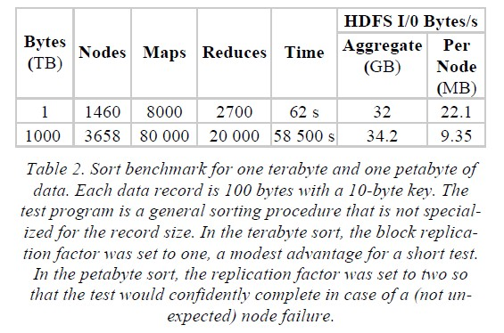
Practice at YAHoo!
Benchmarks
Notes:
For row two, failure is no long uncommon, because, for example, if one machine dies in a thousand machines, when ten thousand machines, ten machines may die. This is a lot. So replica factor being two is necessary.

Slide 43
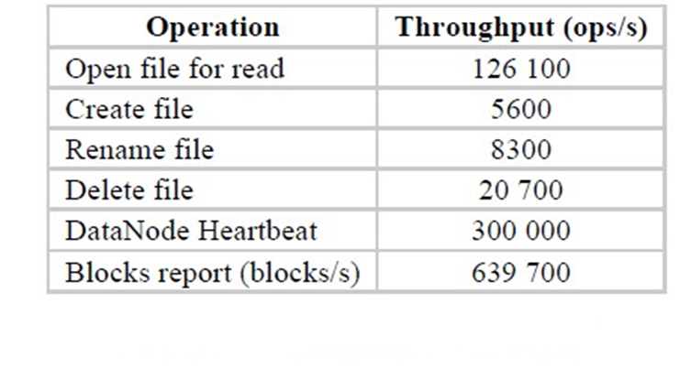
Practice at YAHoo!
Benchmarks
NameNode Throughput benchmark
Notes:
Ops/s is operations per second

Slide 44
FUTURE WORK
Automated failover
plan: Zookeeper, Yahoo’s distributed consensus technology to build an automated failover solution
Scalability of the NameNode
Solution: Our near-term solution to scalability is to allow multiple namespaces (and NameNodes) to share the physical storage within a cluster.
Drawbacks: The main drawback of multiple independent namespaces is the cost of managing them.
Notes:
Again, out of date.

